Slide 1
CALIBER 2020 Hackathon Submission
Team Cognitive Searchers
Sabarish V
Pandiyan S G
Karthikeyan Baskaran
Sriram T
Vetrivel Murugan

Slide 2
Disclaimer

Slide 3

Introduction of the Team with Pictures
This is Sabarish, I’ve totally 5+years of experience and associated with Cognizant since July’19. I am interested to learn cutting edge technologies and right now working in many azure PaaS service with one of the leading banking client in US. In my free time, I used play Football, shuttle etc and sometimes used to prepare for azure certification.

Slide 4
VM Details & Instructions to execute code
VM Details
IP : 40.84.197.108:3389
User Id : calibone
Password : azure@2020
How to Execute the Code (Steps)

Slide 5
Executive Summary

Slide 6
Use Case / Idea

Slide 7
What Problem are we Solving?

Slide 8
Introduction to Solution

Slide 9
What it does (detail it out)?

Slide 10






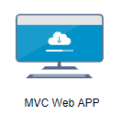





























SaaS
IaaS
PaaS
PRESENTATION
(Audio to text API)
Container 1
Container 2
Container 3
(Image to text API)
Audio file
Video file
Images file
Detailed Architecture

Slide 11
Architecture Explanation
As part of architecture we used IaaS, PaaS, SaaS

Slide 12
Assumptions

Slide 13
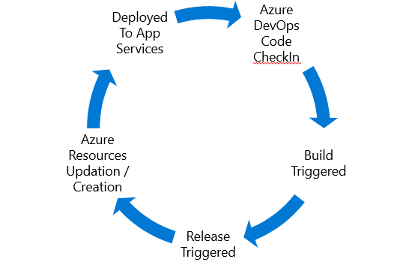
Deployment Architecture Diagram

Slide 14
Technical Details:
We have several reason to go with the azure services, and major summaries aided for our project is listed below:
Azure Search: Its is easy setup, auto scaling, managed, more language support, different options like faceting, suggestions, geo-search, synonyms, scoring etc
Azure media service: By this, we got face detection, celebrity identification, scene segmentation, label identification, noise reduction, translation of voice to text.
Azure cognitive services: we used Speech API, Text API, Language Understanding API, Search API to extract text from the documents, text from audio file, and trained the search with list of intents.
Power virtual agent: Enables to extend bots using azure bot framework skills.
Web apps: To deploy our web application, without maintaining any own VMs.
Webhooks: To make it automated, on creating new audion or video files we created azure function as blob trigger
Keyvault: To store the azure secrets like, storage connection string, search service manager key, azure AD tenant id, secrets.
Azure AD: To secure the web app to access only the registered users.
Power BI: Analytics of the incoming data are visualized since we are supposed used as enterprice search.
Application insights: Track the logs for further analyze and availability of the application such as function app etc.

Slide 15
Demo Link and Demo File
Mandatory to provide a Video file with audio enabled in it and covert it into MP4 format

Slide 16
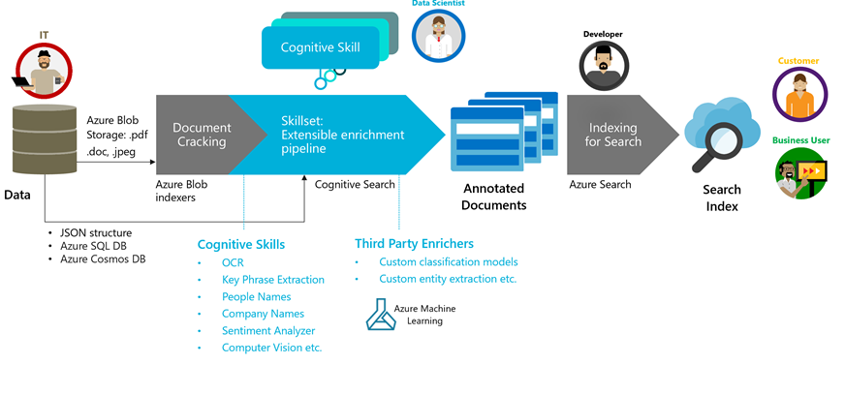
Sample Execution Flow
Audio file
Video file

Slide 17
Next Steps / Future Roadmap

Slide 18
Thank You

